Slide 1

Amazon Customer Churn Prediction

Slide 2
Machine Learning Study for Customer Retention Optimization
Object
Identify customers at risk of churn before they disengage
Approach
Machine learning modeling with explainable AI (SHAP)
Outcome
Actionable retention strategies driven by key churn predictors
Prepared using Machine Learning and SHAP Explainability

Slide 3
Customer Retention Challenge
Churn is one of the costliest threats to sustainable revenue growth. Early identification of at-risk customers is the first step toward building an effective, proactive retention strategy.
Customer churn directly impacts revenue and long-term growth trajectories.
Retaining existing customers is significantly cheaper than acquiring new ones — often 5–7× less costly.
Identifying churn signals early enables targeted, proactive intervention before customers disengage.
Data-driven churn prediction allows businesses to prioritize high-risk customers for retention spend.
Business Challenge
Impact
Customer inactivity
Revenue loss
Customer dissatisfaction
Reduced loyalty and brand equity
Declining engagement
Increased churn probability
Lack of retention targeting
Inefficient marketing spend

Slide 4
Customer Behavioral Data Used
The model was trained on a rich set of behavioral, transactional, and satisfaction signals. Together, these variables capture a 360° view of customer engagement and highlight early warning indicators of churn.
Feature Category
Variables
Customer Activity
orders_4w, spend_4w, sessions_4w
Customer Engagement
pct_orders_with_coupon_4w, avg_discount_pct_4w
Customer Experience
returns_12w, tickets_12w
Customer Satisfaction
avg_csat_12w
Customer Recency
days_since_last_order
Customer Attributes
city_tier, acquisition_channel
Loyalty
prime_active_flag
These variables capture customer activity, engagement, and satisfaction signals — the key behavioral indicators of churn risk identified in the literature and confirmed in model analysis.

Slide 5
Machine Learning Models Evaluated
Nine algorithms spanning linear, tree-based, ensemble, and kernel methods were benchmarked against a consistent holdout test set. This broad evaluation ensures the final selection reflects true predictive superiority rather than model bias
Model
Category
Evaluation Metrics
All models were assessed on the following performance dimensions to ensure balanced predictive quality:
AUC — Discriminatory power
Accuracy — Overall correctness
Precision — Churn prediction reliability
Recall — Churn capture rate
F1 Score — Precision-recall balance
Logistic Regression
Linear Model
Decision Tree
Tree Based
Random Forest
Ensemble Bagging
AdaBoost
Boosting
Gradient Boosting
Boosting
XGBoost
Advanced Boosting
CatBoost
Advanced Boosting
LightGBM
Gradient Boosting
BernoulliNB
Linear Model

Slide 6
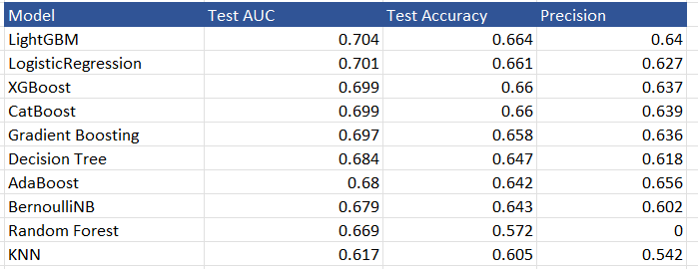
Model Benchmark Results
All nine models were evaluated on a held-out test set. Results show strong consistency across advanced ensemble methods, with CatBoost emerging as the top performer across key metrics.

Slide 7
Selected Model: LightGBM
After comprehensive benchmarking, LightGBM was selected as the final production model. It achieved the highest predictive performance while demonstrating strong generalization and minimal overfitting — critical requirements for reliable deployment.
Performance Summary
Metric Value
Train AUC 0.733
Test AUC 0.704
Train Accuracy 0.679
Test Accuracy 0.664
Why LightGBM?
Highest AUC among all benchmarked models
Minimal overfitting — near-zero gap between train and test performance
Handles Large Data Easily
Lower Memory Usage

Slide 8
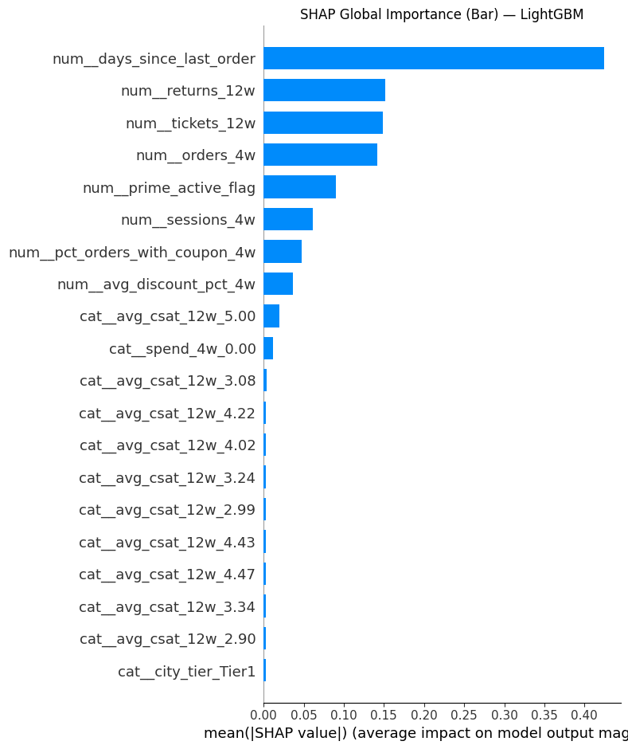
Top Drivers of Customer Churn
SHAP (SHapley Additive exPlanations) analysis quantifies the contribution of each feature to individual churn predictions — translating the model's decisions into interpretable business insights without sacrificing predictive accuracy.
SHAP Global Feature Importance
Ranked Churn Drivers
Rank
Driver
1
Days Since Last Order
2
Customer Satisfaction (CSAT)
3
Product Returns
4
Support Tickets Filed
5
Recent Spend
6
Loyalty Membership (Prime)
7
Recent Orders
8
Customer Sessions

Slide 9
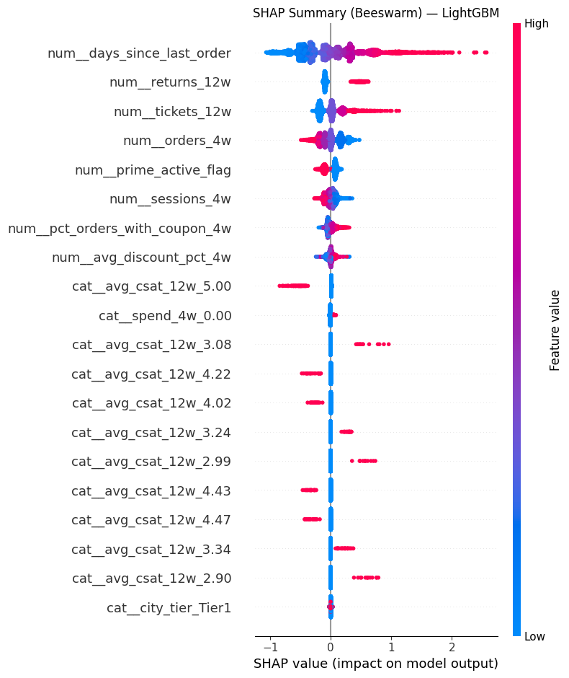
Customer Behavior Patterns Leading to Churn
The SHAP beeswarm plot below illustrates the directional impact of each feature across all customers — revealing not just what drives churn, but how and at what thresholds behavioral signals become most predictive.
Returns and Tickets Signal Friction
Higher product return rates and unresolved support tickets are strongly associated with dissatisfaction and upstream churn risk.
Inactivity Is the Strongest Signal
Customers who remain inactive for extended periods are significantly more likely to churn — recency is the single most predictive behavioral variable.
Satisfaction Drives Retention
Lower CSAT scores substantially increase churn risk. Dissatisfied customers are far less likely to return without direct intervention.
Declining Purchase Activity
A measurable drop in spending and order frequency consistently precedes customer churn, serving as a leading indicator for intervention.

Slide 10
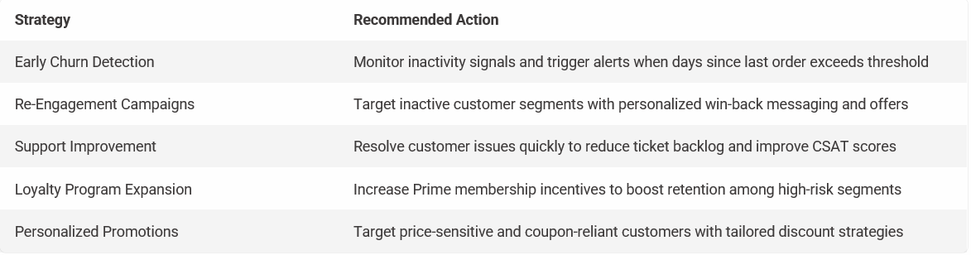
Customer Retention Strategy
The churn model transforms raw predictions into a prioritized action framework. Each strategy below maps directly to a key churn driver identified through SHAP analysis — enabling precise, data-backed retention investment.

Slide 11
Thank you

